Slide 1
ASSIGNMENT
Drones in Healthcare
Made by:- Yusuf j
Hemanth j
Sagar h
Ijaz h

Slide 2
What is a drone?
A drone is an unmanned aircraft. Drones are more formally known as unmanned aerial vehicles (UAVs) or unmanned aircraft systems. Essentially, a drone is a flying robot that can be remotely controlled or fly autonomously using software-controlled flight plans in its embedded systems, that work in conjunction with onboard sensors and a global positioning system (GPS).
How do drones work?
Drones have two basic functions: flight mode and navigation.
To fly, drones must have a power source, such as battery or fuel. They also have rotors, propellers and a frame. The frame of a drone is typically made of a lightweight, composite material to reduce weight and increase maneuverability.
Drones require a controller, which lets the operator use remote controls or it is automated to launch, navigate and land the aircraft. Controllers communicate with the drone using radio waves, such as Wi-Fi.

Slide 3
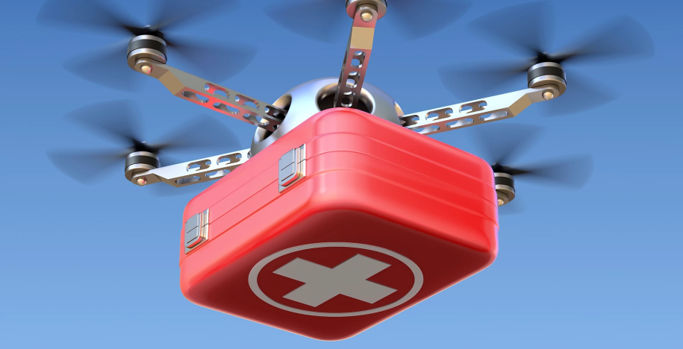
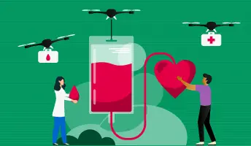
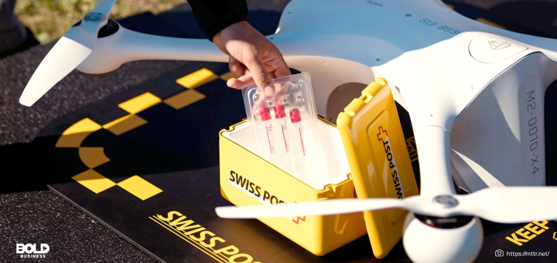
Drones in Healthcare
Discover How Drones can Save Lives by
Delivering Urgent Supplies
Transferring Medical Samples between Labs
Reacting quickly during disasters

Slide 4
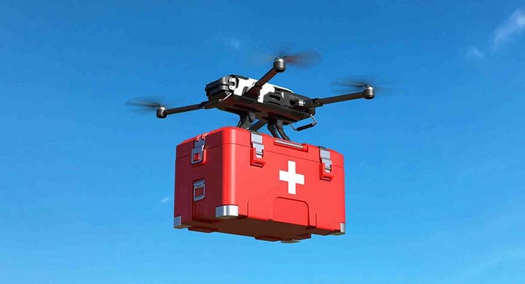
Medical supply delivery in India
UAVs can be used to deliver urgent and precious supplies
■ Especially advantageous for Delivering
■ To rural areas,
■ Supplies that expire in short time
■ To Home bound patients
■ To offshore vessels
Example: Blood transfer to local hospitals
■ Blood is expensive and expires quickly — platelets and thawed plasma last only a few days
■ Small hospitals can only stock limited amounts
■ In emergencies; Drones can save lives by delivering blood rapidly
Transportation of blood samples

Slide 5
How drones will be helpful for medical purpose in India
The Indian Council of Medical Research (ICMR) released guidelines for drone use in the healthcare sector to ensure access to medicines, vaccines and other paraphernalia to all, especially in the geographically difficult terrains in the country.
The move was based on an October 2021 pilot project conducted in Manipur and Nagaland, where COVID-19 vaccines, vaccines for routine immunisation programmes such as measles, mumps and rubella, antenatal care medicines, multi-vitamins, syringes and gloves were delivered.

Slide 6
The guidelines were released on June 2 during the Bharat Drone Mahotsav 2022 in Delhi. It was based on field experience, which included an indegenious drone transporting COVID-19 vaccines in 12-15 minutes over an aerial distance of 15 kilometres from Manipur’s Bishnupur district hospital to a primary health centre in Loktak lake, Karang island.
The COVID-19 pandemic has highlighted fissures in the healthcare supply chain across the world and India is no exception. As per Our World in Data, 72.61 per cent of the population has either fully or partially completed their vaccination protocol as of June 2.

Slide 7
Working Mechanism
Drone controlling centre is established on the centre of a city so that all the hospitals can contact easily for necessary needs.
Drone carries a special container box that has a cooling system to carry blood and human organs to transport from one place to another place.
All the necessary need can be supplied from a donor hospital to the required hospital.

Slide 8
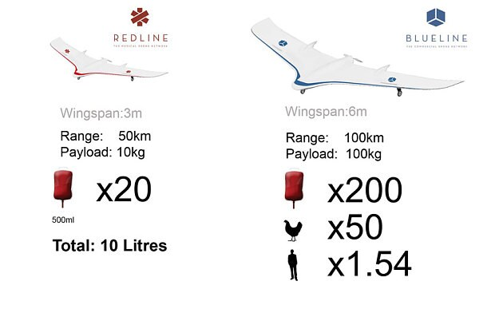
Medical Drones

Slide 9
Medical Disaster Relief
■ Rapid Response following
■ Floods
■ Earthquakes
■ Hurricanes
■ Avalanches
■ UAVs can help delivering Medicines and Aid Kits after disasters

Slide 10
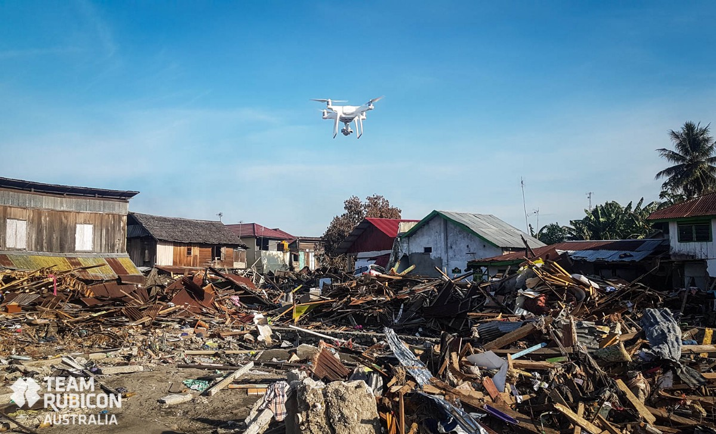
Haitian Earthquake relief
■ After the Haitian earthquake in 2012, drones were used to deliver
■ Medicine
■ Eatables
■ Other Essential Supplies

Slide 11
Medical Sample Transportation
Medical Sample test Procedures
■ Most labs only apply a single test to a sample
■ Then send it on to another specialist lab
■ There is a strict time limit between tests
UAVs can provide invaluable assistance in
■ Delivering samples between specialist labs
■ Both Urban & Suburban areas

Slide 12
Delivering Emergency Medical Aid
Depending on the type of emergency
■ Drones can carry necessary tools to incident scene
■ Response time to an emergency makes all the difference
A Simple Example:
■ An ambulance drone can get a defibrillator to a patient in 1 minute
■ Within a 12 square kilometers (4.6 square miles) zone
■ Increasing the chance of survival from 8% to 80%

Slide 13
THANKYOU

